Slide 1
QI Webinar:
Health Numeracy
January 11, 2022

Slide 2

Introductions
Please share your name and agency in the chat room

Slide 3
Reminder about Basic Zoom Functions

Slide 4


Good Practices for Zoom Participation
Re-label your Zoom tile to state your name
Keep video on and mute your line when needed
Use the chat room to ask for clarifications, post questions, or share your wisdom
Please be reminded that we will record our session for later replay!

Slide 5
You allow us to take pictures from our training events and post them on SharePoint
You have the right to revoke your consent for pictures that are publicly posted
At no time will individual names be used to identify you, unless you sign the appropriate release form

Slide 6
Agenda
Welcome and Objectives
Health Numeracy and Decision-Making
Factors Related to Understanding Quantitative Health Information
Skills and Competencies for Understanding Quantitative Health Information
Tips for Presenting Quantitative Health Information for Patients
Questions and Closing

Slide 7
Learning Objectives
Increase knowledge of patient and provider factors that contribute to patient understanding of numeric health information
Identify skills and competencies required for accessing, analyzing, and applying quantitative health information
Identify best practices and tips for presenting quantitative health information to patients

Slide 8
Polling Question
What value is associated with the definition of “Viral Suppression”
>200 copies/mL blood
≥ 200 copies/mL blood
< 200 copies/mL blood
< 50 copies/mL blood
< 20copies/mL blood
0 copies/mL blood

Slide 9
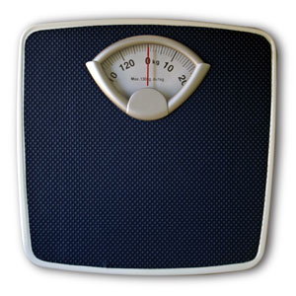

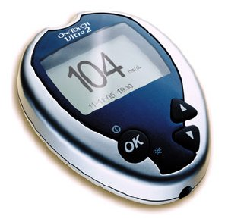

Numbers, Numbers, Numbers

Slide 10
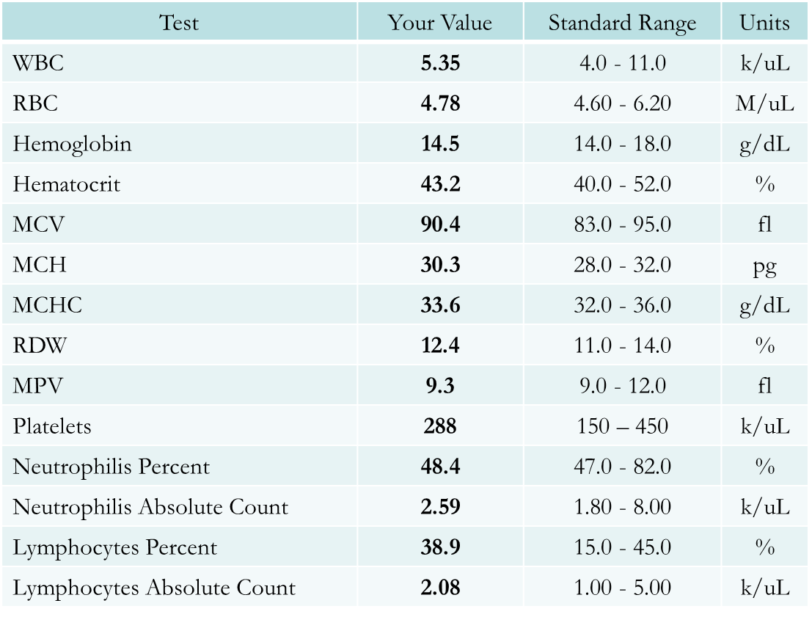

Slide 11
Health Numeracy &
Decision Making

Slide 12
Health Numeracy Defined
Health numeracy can be considered “the individual-level skills to obtain, interpret, and process quantitative information for health behavior and decisions”
Ancker JS, Kaufman D.J. Rethinking Health Numeracy: A Multidisciplinary Literature Review. Am Med Inform Assoc. 2007 Nov-Dec; 14(6):713-21.

Slide 13
Health Numeracy & Decision Making
Having fewer numeric skills, however, is associated with lower comprehension and less use of health information.1
Many patients cannot perform the basic numeric tasks required to function in the current health care environment.2
26% were unable to understand information about when an appointment was scheduled.3
16% of highly educated people incorrectly answered straightforward questions about risk magnitude.4
¹Ellen Peters, Judith Hibbard, Paul Slovic and Nathan Dieckmann Numeracy Skill And The Communication, Comprehension, And Use Of Risk-Benefit Information. Health Affairs, 26, no.3 (2007): 741-748
²ibid
³M.V. Williams et al, “Inadequate Functional Health Literacy among Patients at Two Public Hospitals,” Journal of the American Medical Association 274, no. 21 (1995): 1677-1682
⁴Lipkus, I. M., Samsa, G., & Rimer, B. K. (2001). General performance on a Numeracy Scale among highly educated samples. Medical Decision Making, 21(1), 37-44

Slide 14
A New Definition of “Health Literacy”
“A traditional definition of health literacy concerns individual patients’ abilities. We believe that this definition should also include the format of the provided information and what it requires from patients”
Ellen Peters, Judith Hibbard, Paul Slovic and Nathan Dieckmann Numeracy Skill And The Communication, Comprehension, And Use Of Risk-Benefit Information. Health Affairs, 26, no.3 (2007): 741-748

Slide 15
Factors Contributing to a Patient’s Ability to Use Quantitative Information for Health

Slide 16
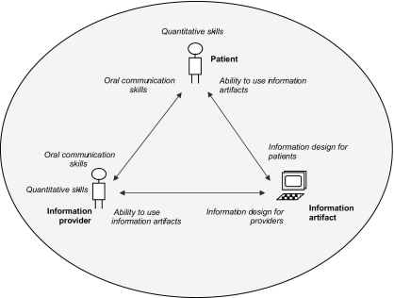
Ancker JS, Kaufman D.J. Rethinking Health Numeracy: A Multidisciplinary Literature Review. Am Med Inform Assoc. 2007 Nov-Dec; 14(6):713-21.

Slide 17
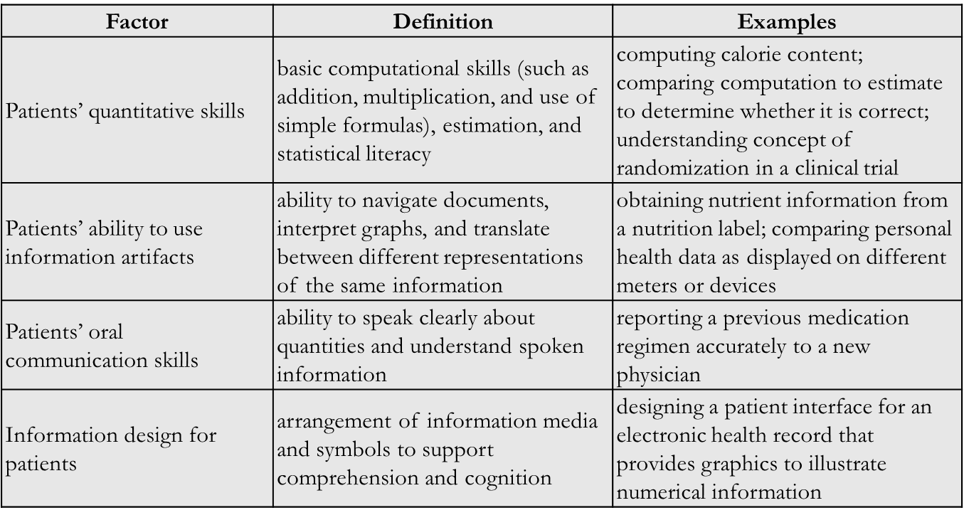
Patient Factors
Ancker JS, Kaufman D.J. Rethinking Health Numeracy: A Multidisciplinary Literature Review. Am Med Inform Assoc. 2007 Nov-Dec; 14(6):713-21.

Slide 18
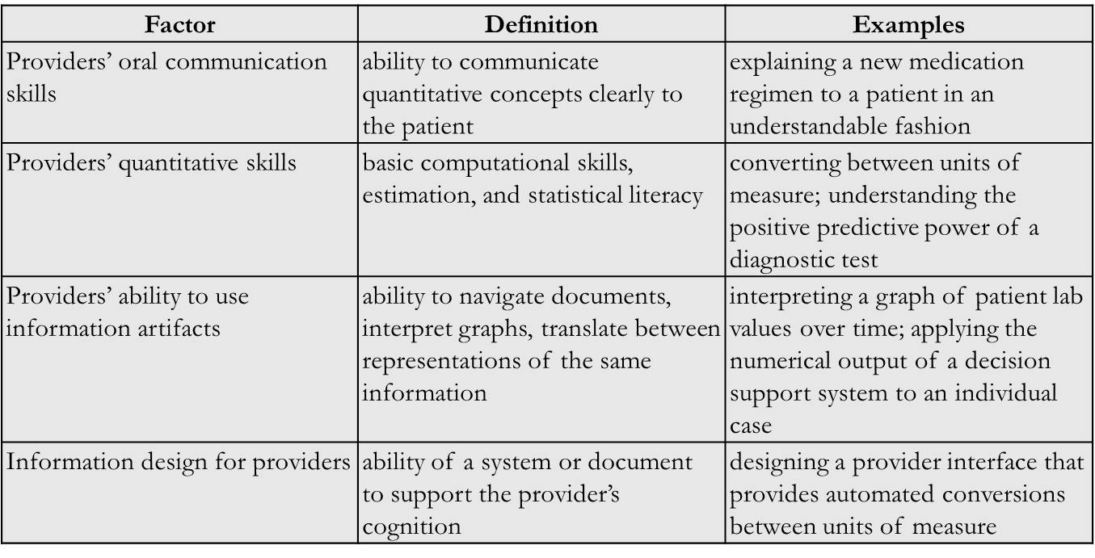
Provider Factors
Ancker JS, Kaufman D.J. Rethinking Health Numeracy: A Multidisciplinary Literature Review. Am Med Inform Assoc. 2007 Nov-Dec; 14(6):713-21.

Slide 19
Health Numeracy Skills and Competencies

Slide 20
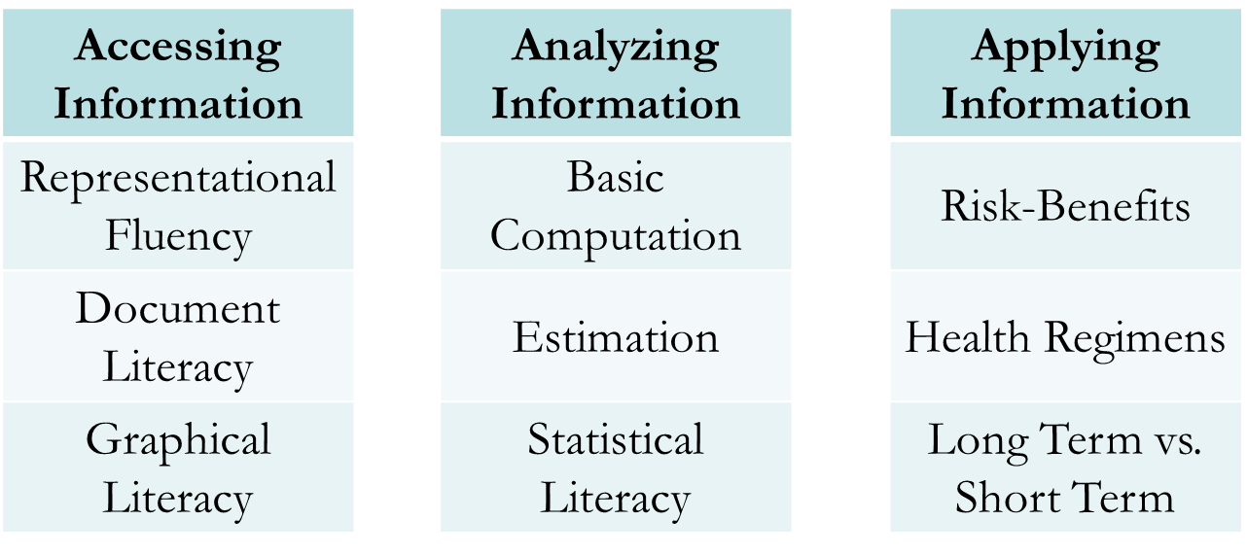
Skills and Competencies

Slide 21
Skills for Understanding Information Artifacts
Representational Fluency
  “Representational fluency is the ability to translate between and recognize the identity of different representations of the same quantity.”
Document Literacy
  “Quantitative information is often provided in the form of a complex print or electronic document that combines text with lists, forms, or tables.”
Graphical Literacy
  “The ability to interpret quantitative graphics helps people use educational materials, news reports, and electronic systems.”
Ancker JS, Kaufman D.J. Rethinking Health Numeracy: A Multidisciplinary Literature Review. Am Med Inform Assoc. 2007
Nov-Dec; 14(6):713-21.

Slide 22
Quantitative Skills: Individual Level Competencies
Basic Computation
  Number recognition, comparisons, arithmetic, use of simple formulas
Estimation
  Using estimates instead of calculations to make decisions
Statistical Literacy
  Understanding of concepts related to change, uncertainty, sampling, margins of error, and randomization to evaluate scientific information
Ancker JS, Kaufman D.J. Rethinking Health Numeracy: A Multidisciplinary Literature Review. Am Med Inform Assoc.
2007 Nov-Dec; 14(6):713-21.
Notes:
“Basic computation encompasses number recognition and comparisons, arithmetic, and the use of simple formulas. The TOFHLA ¹⁰ screening test for comprehension of written health information assesses these skills with questions such as computing times for taking a pill, comparing a blood sugar level to a standard to decide whether it is abnormal, and interpreting an appointment slip. In the validation sample, of whom 31% had education beyond high school, only 25% answered all four numeracy questions correctly.”
“Adult education theorists point out that people perform precise calculations only in certain situations, such as completing financial forms, which have been termed generative situations. ¹³However, people solve many real-world problems not by calculating but by estimating or using number sense (a basic feel for magnitudes and operations). ³⁷ Applying an estimation heuristic is generally quicker and simpler than calculating and is often sufficient for decision situations (e.g., choosing groceries while meeting a budget). ¹³ Estimates may also help in interpretive situations ¹³ such as reading a news article, as well as in judging the probable correctness of a calculation. As many health situations involve interpreting quantitative information or making decisions, these examples from the adult education literature suggest that the role of estimation in health contexts warrants further study.”
“Statistical literacy is an understanding of concepts such as chance and uncertainty, sampling variability, margins of error, and randomization in clinical trials, and the ability to use such concepts to evaluate scientiﬁc information.”

Slide 23
Numerical Skills Associated with the
Quality of Health Decisions
Evaluating Risks and Benefits of Health Options
Following Complex Health Regimens
Weighing Short-Term against Long-Term Benefits
Ellen Peters, Judith Hibbard, Paul Slovic and Nathan Dieckmann Numeracy Skill And The Communication, Comprehension, And Use Of Risk-Benefit Information. Health Affairs, 26, no.3 (2007): 741-748

Slide 24
Presenting Numeric Health Information

Slide 25
Best Practices in Presenting Numeric
Health Information
Less is often more
Reduce required inference and calculations
Test formats carefully to reduce numeracy effects
Other aids
Ellen Peters, Judith Hibbard, Paul Slovic and Nathan Dieckmann Numeracy Skill And The Communication, Comprehension, And Use Of Risk-Benefit Information. Health Affairs, 26, no.3 (2007): 741-748

Slide 26
Approaching Health Numeracy
Assume Patients lack knowledge of quantitative concepts
Focus on one idea at a time
Use numbers when they are really needed
Find out which measurement system your patient uses
Offer support for ideas*
Helen Osborne, M.Ed., OTR/L , “Health numeracy: How do patients handle the concept of quantity when it relates to their health?” accessed from: http://www.boston.com/jobs/healthcare/oncall/articles/2007/09/19/health_numeracy on 04/11/13

Slide 27
Offering Support for Ideas
Draw a picture
Use analogies or reference points to explain quantity
Show physical representations of quantity
Encourage patients to create their own images
Use vivid language
Teach with stories
http://www.boston.com/jobs/healthcare/oncall/articles/2007/09/19/health_numeracy/
Notes:
1. Draw a picture showing what the thermometer looks like when a person's temperature is too high.
2. Use analogies or reference points to explain quantity. Joram says that dietitians often do this by comparing meat portions to a deck of cards or the size of a person's fist.
3. Show physical representations of quantity. An example is a dinner plate sectioned off into the correct amount of vegetables, protein, and carbohydrates.
4. Encourage patients to create their own images. Joram mentions one man who says his image of a mile is four laps around the high-school track.
5. Use vivid language. Joram finds that newspaper journalists often present quantitative information in vivid and understandable ways, such as writing that the stock market "inched up" or "went on a roller-coaster ride." Healthcare providers can do likewise by using colorful and descriptive language when talking about numbers.
6. Teach with stories. When instructing patients about the need to walk 3 times a day for a total of 30 minutes, you might use the example of a woman who takes short walks after breakfast, lunch, and dinner. For many people, this narrative is easier to understand and remember than dividing 30 minutes by 3.

Slide 28
Key Points
Patients need more skills and knowledge to understand quantitative health information
Different skills are needed to access, process, and apply numerical health information
Providers should closely evaluate their use of numbers when explaining health information to patients
A picture is worth a 1000 decimal points
Make the numbers relevant and meaningful
Notes:
1. Draw a picture showing what the thermometer looks like when a person's temperature is too high.
2. Use analogies or reference points to explain quantity. Joram says that dietitians often do this by comparing meat portions to a deck of cards or the size of a person's fist.
3. Show physical representations of quantity. An example is a dinner plate sectioned off into the correct amount of vegetables, protein, and carbohydrates.
4. Encourage patients to create their own images. Joram mentions one man who says his image of a mile is four laps around the high-school track.
5. Use vivid language. Joram finds that newspaper journalists often present quantitative information in vivid and understandable ways, such as writing that the stock market "inched up" or "went on a roller-coaster ride." Healthcare providers can do likewise by using colorful and descriptive language when talking about numbers.
6. Teach with stories. When instructing patients about the need to walk 3 times a day for a total of 30 minutes, you might use the example of a woman who takes short walks after breakfast, lunch, and dinner. For many people, this narrative is easier to understand and remember than dividing 30 minutes by 3.

Slide 29


Slide 30
Notes:
How helpful was today’s session to learn about quality improvement?
[1-not at all helpful, 2-not so helpful, 3-somewhat helpful, 4-very helpful, 5-extremely helpful]

Slide 31
Notes:
How engaged were you in today’s session?
[not at all engaged, 2-rarely engaged, 3-somewhat engaged, 4-engaged, 5-extremely engaged]

Slide 32
Notes:
How likely will you implement the lessons learned of this session when working with your programs?
[1-very unlikely, 2-somewhat unlikely, 3-neither likely nor unlikely, 4-somewhat likely, 5-very likely]

Slide 33


Slide 34
Contact Information
Kevin Garrett, MSW
Senior Manager, CQII
New York State Department of Health
AIDS Institute
90 Church Street, 13th floor
New York, NY 10007-2919
Kevin.Garrett@health.ny.gov

